Slide 1
Worker Engagement

Slide 2
Health and Safety at Work Act 2015
Duty holders, including owners or persons conducting a business or undertaking (PCBUs), have an obligation to engage with and enable the participation and representation of workers.
A PCBU should regularly discuss health and safety issues at their work with their workers.

Slide 3
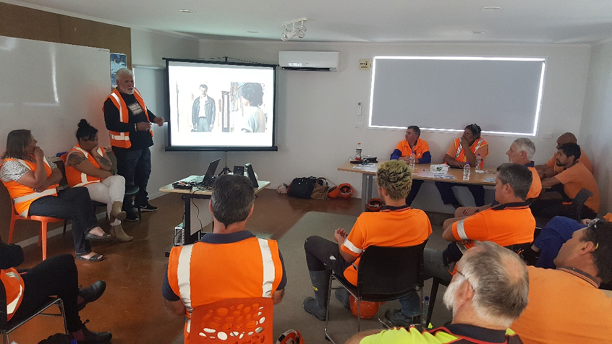
Involving workers in health and safety matters and decisions in the workplace
Share information and decisions in a timely manner
Give workers reasonable opportunities to share their views, raise work health or safety issues, and contribute to the decision-making processes
Consider the views of workers
The key is good communication

Slide 4
What does good communication look like?
Top 5 communication skills
Listening
Non-verbal communication
Clear and concise
Empathy
Open-mindedness

Slide 5
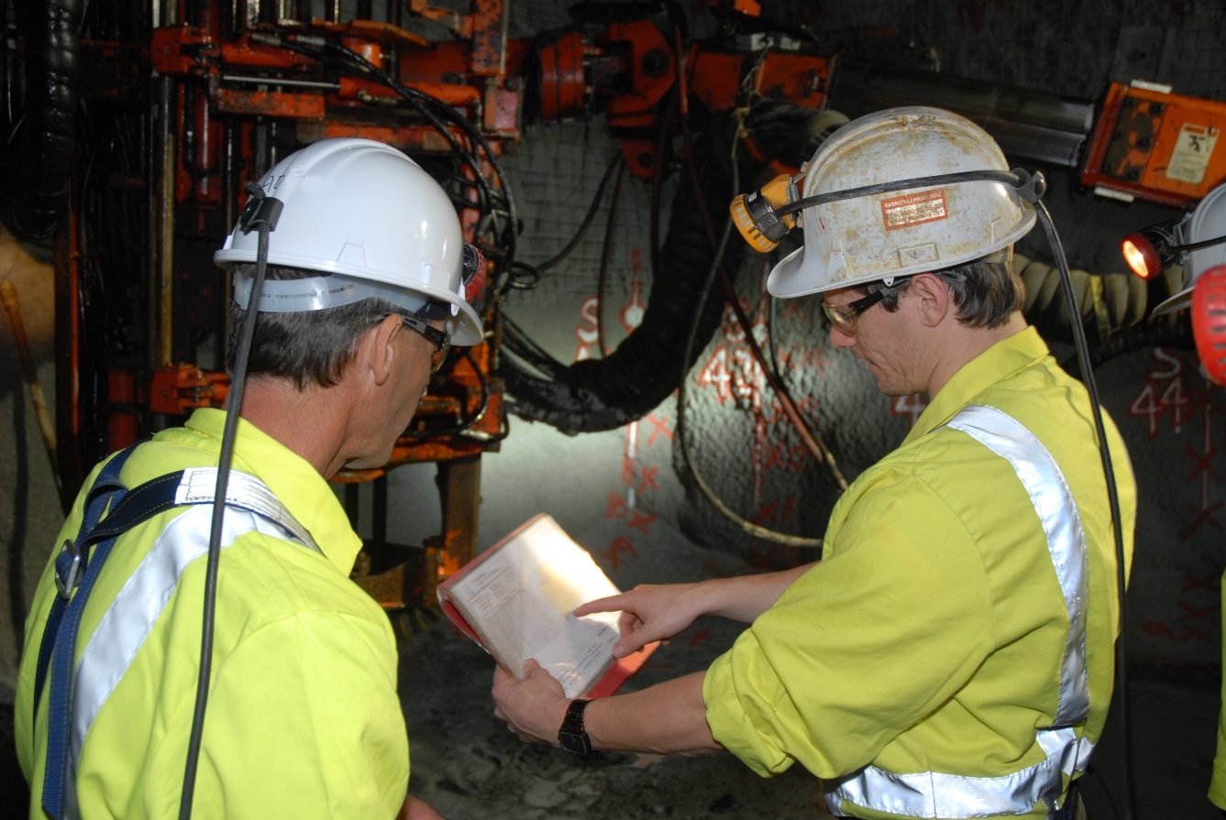
Challenge - Changing mindsets and behaviour
Personal stories are very powerful
Challenge the belief that “it won’t happen”
Put in the time (conversations)
Put yourself in their shoes
May need to just manage behaviour

Slide 6
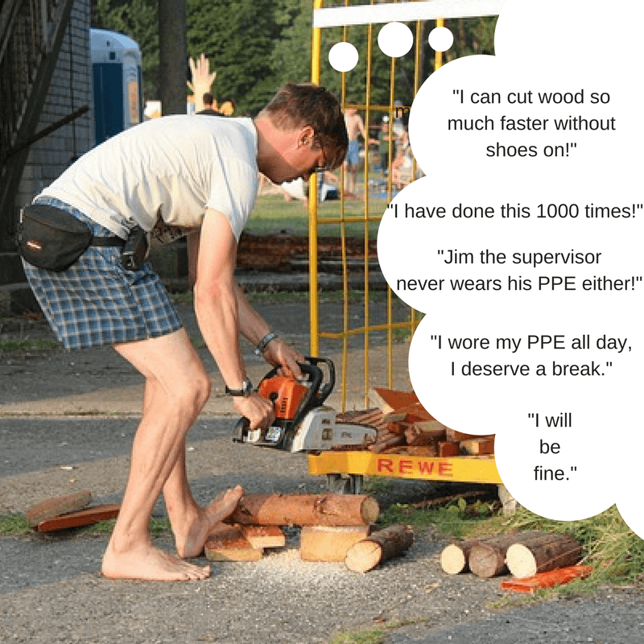
Behaviour is influenced by consequences
Positive or Negative
Immediate or Future
Certain or Uncertain
PICs and NICs are very powerful

Slide 7
How do you engage with workers?

Slide 8
Examples
A company introduced a whiteboard where people can proactively write up any health and safety issues, and a deadline is set for resolving them. All issues get added to the board, and workers are updated on progress at meetings.
At this quarry, the site shuts production for one day per month. A skeleton crew continue with sales, and the rest of the site complete safety training, conduct safety inspections, review safe work procedures and a site safety meeting is conducted.
er work distractions.
The Senior Leadership Team are required to undertake specific interactions with workers. Topics to discuss include; their personal motivations for being here, what they like/don’t like about their job, any specific hazards they see on the site, questions about their job, hazards, issues, any previous incidents with the work they are undertaking etc.

Slide 9
Introduction to Health and Safety Management Systems
Wayne Scott
Email: wayne@minex.org.nz
Mobile: 021 944 336

